Slide 1
Biodiversity knowledge synthesis: an introduction to meta-analyses and systematic reviews Why do we need systematic review
and evidence maps?
October 2022
Beillouin Damien
Chercheur CIRAD- Hortsys

Slide 2

Seeing the forest for the trees
Systematic reviews are the remote-sensing tools of ecology.
They allow us to step back & see a broader, albeit less detailed overview of how a system operates.
(Hillebrand & Cardinale 2010)

Slide 3

Focus…

Slide 4

Step back!
Depicts 106,000 aluminum cans, the number used in the US every 30s

Slide 5
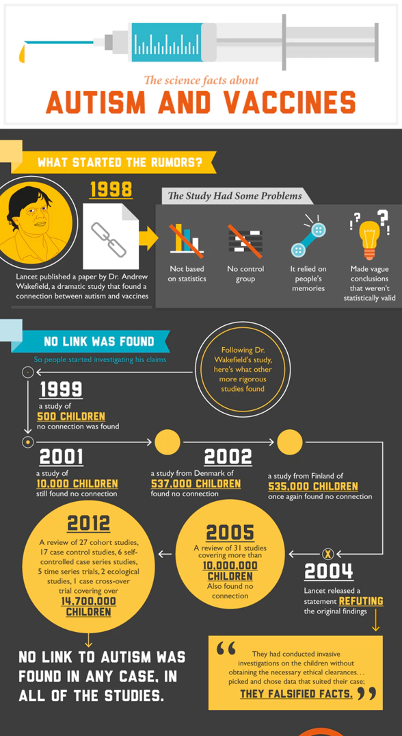
Do you think the folowing statement is true or false?
« Some vaccines cause autism in healthy children. »
Healthcare-management-degree.net

Slide 6
Misinformation
Healthcare-management-degree.net

Slide 7
Misinformation
Healthcare-management-degree.net

Slide 8
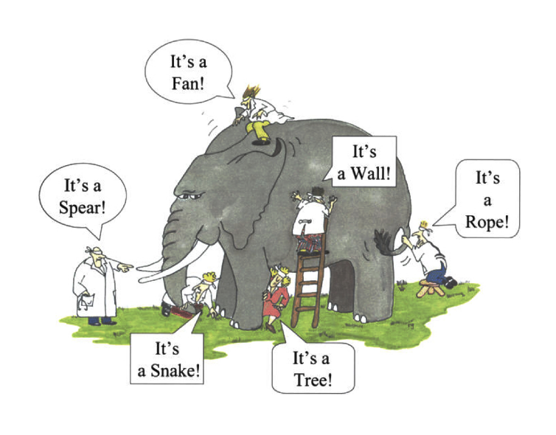
Contradictatory evidence

Slide 9
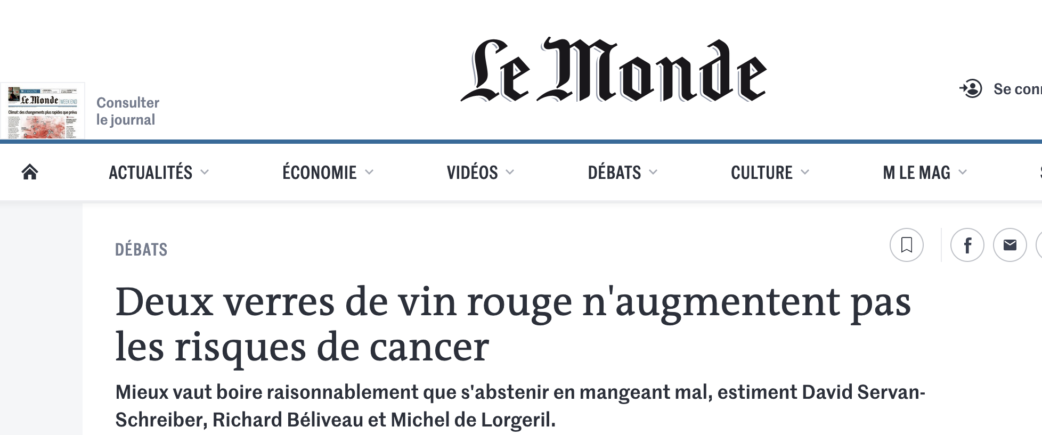
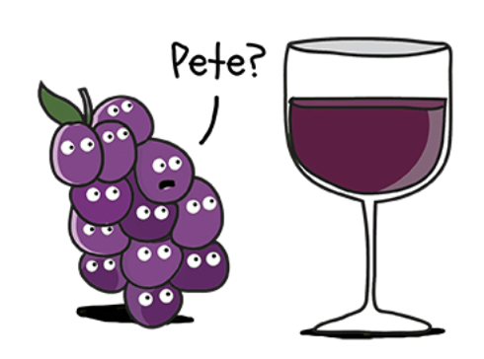

Contradictatory evidence

Slide 10
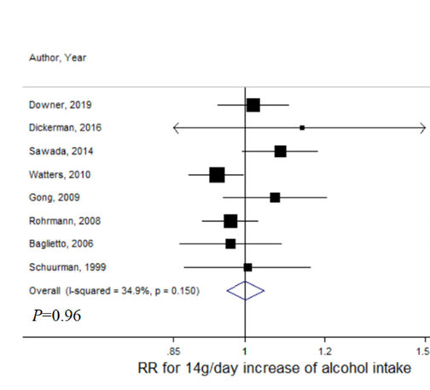
Contradictatory evidence
Cancer de la prostate

Slide 11
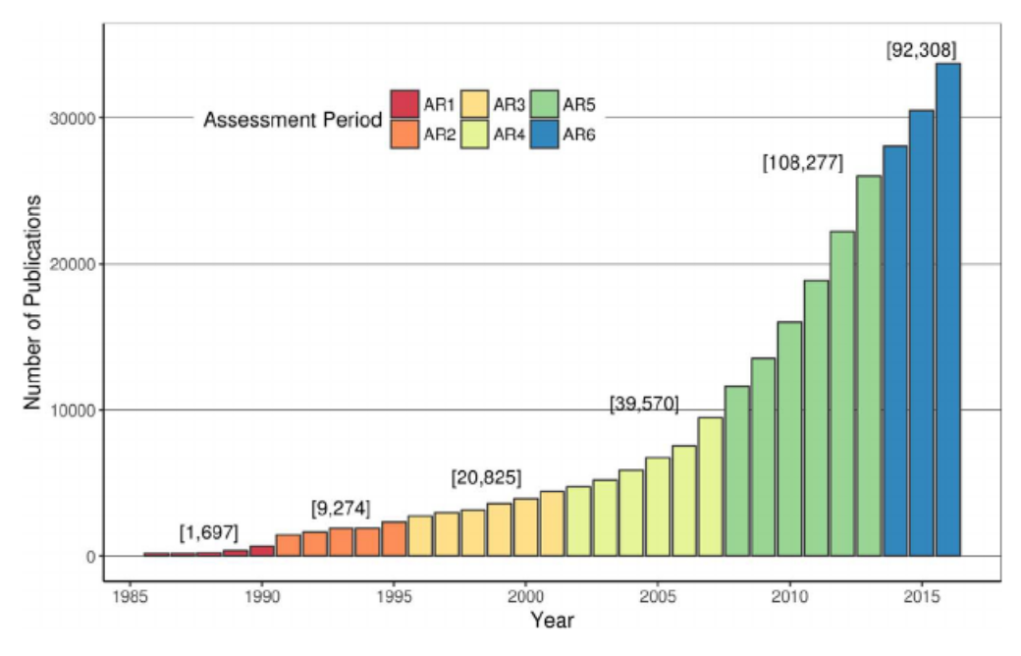
A plethora of scientific articles
Minx J.C., Callaghan M., Lamb W.F., Garard J., Edenhofer O. 2017. Learning about climate change solutions in the IPCC and beyond. Environmental Science and Policy 77, 252-259

Slide 12
A plethora of scientific articles
~63% of the published literature cited in the 1st assessment report
~23% of the published literature cited in the 5th assessment report

Slide 13
A real need for reliable evidence
to objectify knowledge, accurately estimate phenomena and their effects, and sometimes even answer questions that have not been asked by individual studies.

Slide 14
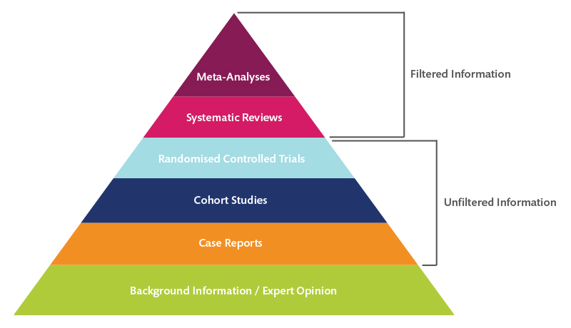
Levels of evidence pyramid

Slide 15

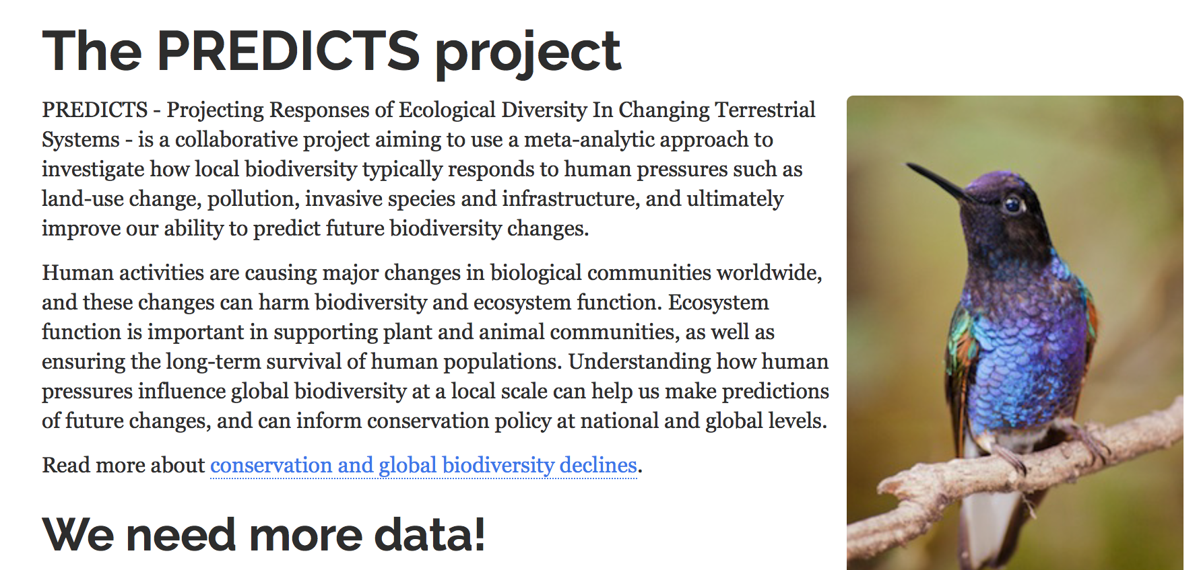
Example of meta-analyses in Ecology

Slide 16
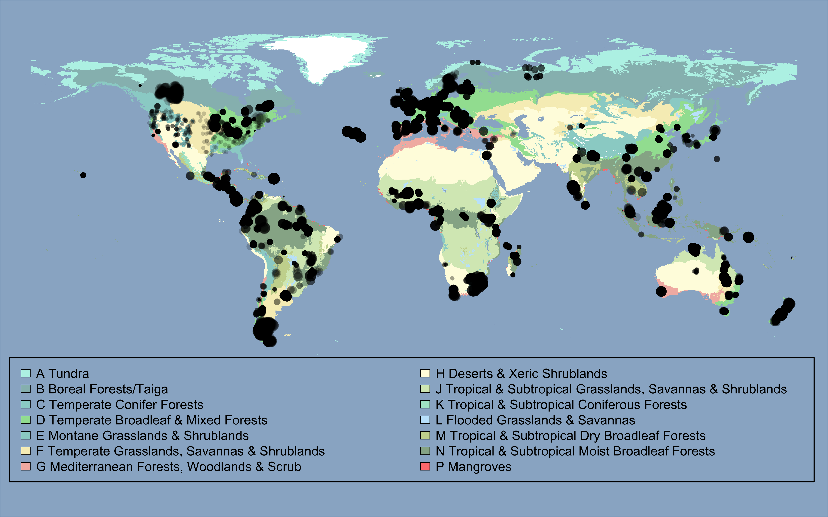
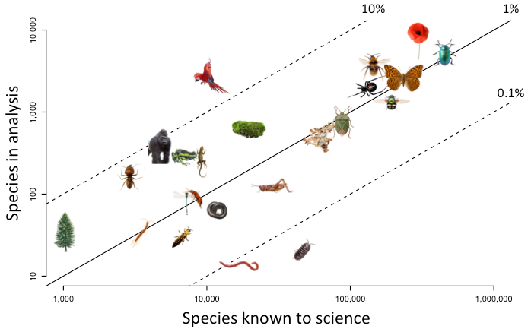
Example of meta-analyses in Ecology
> 32,000 sites
> 50,000 species
> 3.6 million records
Hudson et al. (2014), Ecology and Evolution

Slide 17
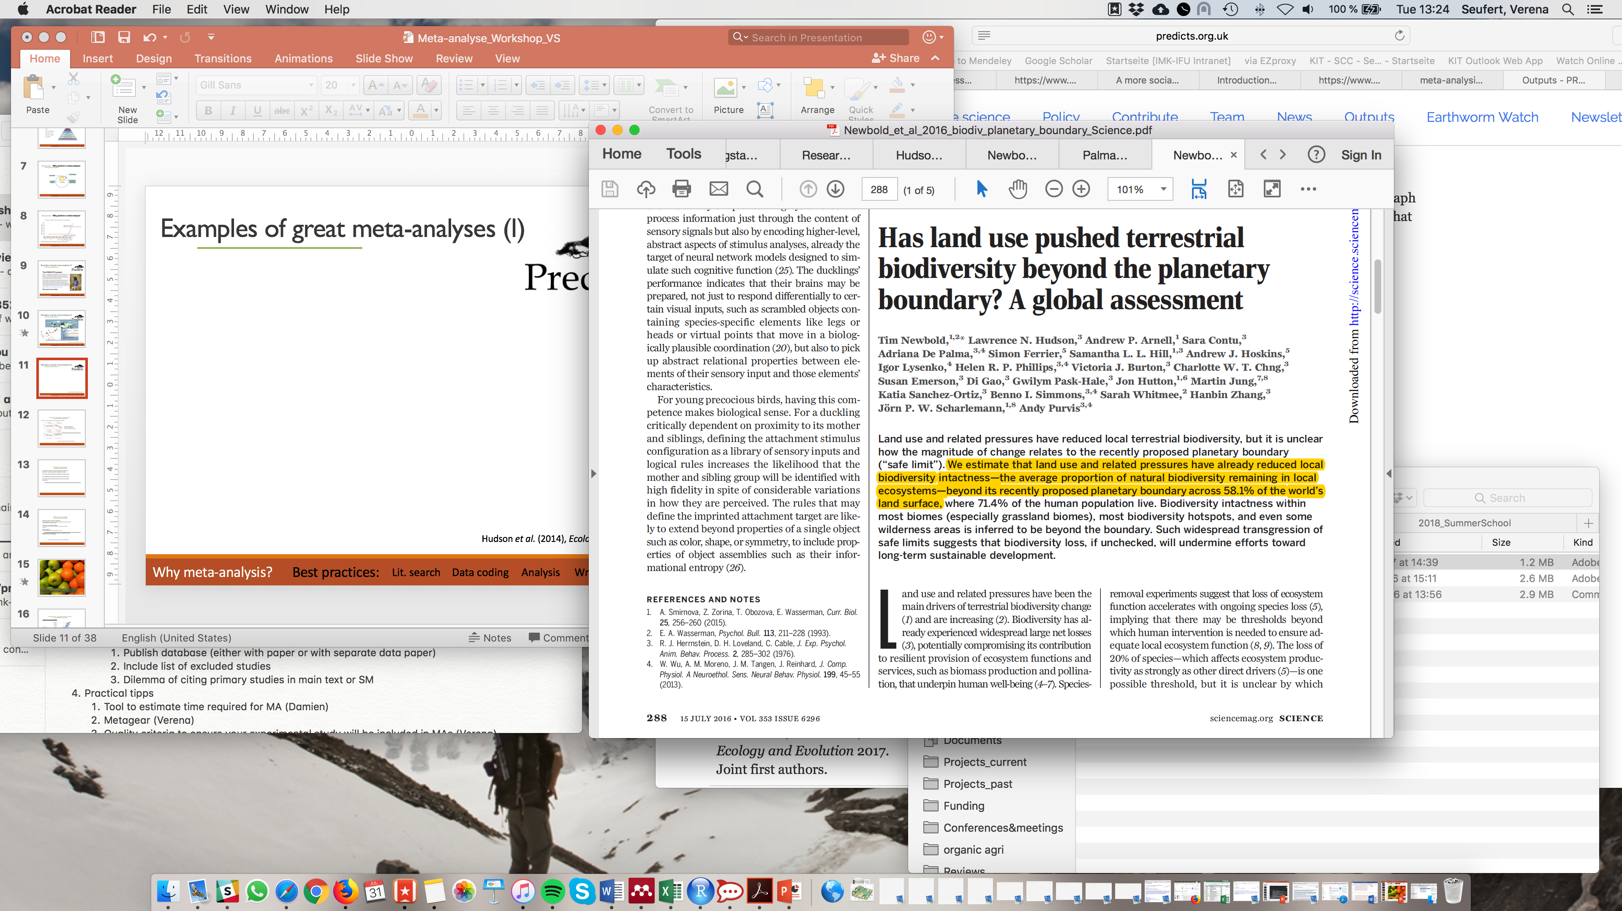
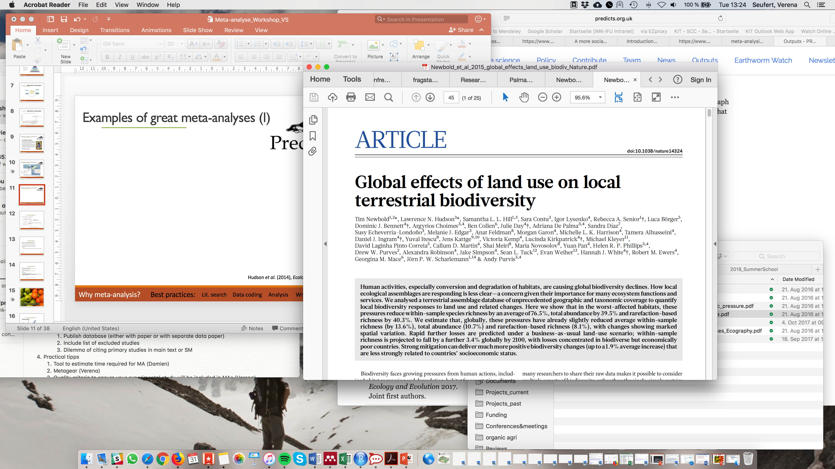
Example of meta-analyses in Ecology
Newbold et al. (2015), Nature
Newbold et al. (2016), Science

Slide 18
Example of meta-analyses in Ecology
Outwhaite et al. (2022), Nature

Slide 19
A review is ….?
an overview or summary of existing research
Evidence maps
Systematic review
Realist review
Literature review
Meta-analysis
Scoping review
Rapid review
Narrative review
Meta syntheses
Systematic literature review
Integrative review

Slide 20
What are the differences?
Aim of the review:
Describe
Quantify
//
What research exists on a topic?
What does the study results show?
Effort to find the papers:
Effort to find the papers:
Low
Systematic
Moderate
Systematic
Narrative
review
Scopping
review
Systematic
maps
Rapid
review
Meta-analyses
Type of paper synthesised:
//
Primary research
Syntheses
1st order MA
2nd order MA

Slide 21
What are the differences?
Aim of the review:
Describe
Quantify
//
What research exists on a topic?
What does the study results show?
Effort to find the papers:
Effort to find the papers:
Low
Systematic
Moderate
Systematic
Narrative
review
Scopping
review
Systematic
maps
Rapid
review
Meta-analyses
Type of paper synthesised:
//
Primary research
Syntheses
1st order MA
2nd order MA

Slide 22
Strengths of evidence maps
1. Visual representation of the knowledge accumulated/gaps
(i.e. no need to read hundreds of primary studies!)
2. Typology/categorization of the research
(often term and definition varies a lot to represent a same phenomena/practice )
3. Offer a foundation for further, more focused research synthesis
(a first step for a new meta-analyis)
4. Political/scientific agenda for future research

Slide 23
Weakness of evidence maps
1. Only descriptive – no analyses
(i.e. do not inform on the effectiveness of the tested interventions)
2. The results could also be presented in meta-analyses
(beware of redundancies!)

Slide 24
What are the differences?
Aim of the review:
Describe
Quantify
//
What research exists on a topic?
What does the study results show?
Effort to find the papers:
Effort to find the papers:
Low
Systematic
Moderate
Systematic
Narrative
review
Scopping
review
Systematic
maps
Rapid
review
Meta-analyses
Type of paper synthesised:
//
Primary research
Syntheses
1st order MA
2nd order MA

Slide 25








Strengths of meta-analyses
1. See the forest for the trees
(i.e. see effects and relationships that might not be visible in individual studies)
2. Synthesize knowledge on controversial issues
(find average effect while trying to minimize bias)
3. Can compare apples and oranges (to some degree)
(meta-analysis is specifically designed to deal with heterogeneity)
4. Identify knowledge gaps
(very important role of meta-analysis!)
5. Examine reasons for variation (to some degree)

Slide 26




Weakness of meta-analyses
1. See the tree for the forest
(i.e. apply results to individuals)
2. Cannot overcome bias
(e.g. partial synthesis, publication bias, subjective methods choices)
3. Comparing apples and oranges
(combining things that should not be combined)
4. Not representative
(Study population = scientific studies, ≠ population of interest)
5. Not able to examine causality
?

Slide 27
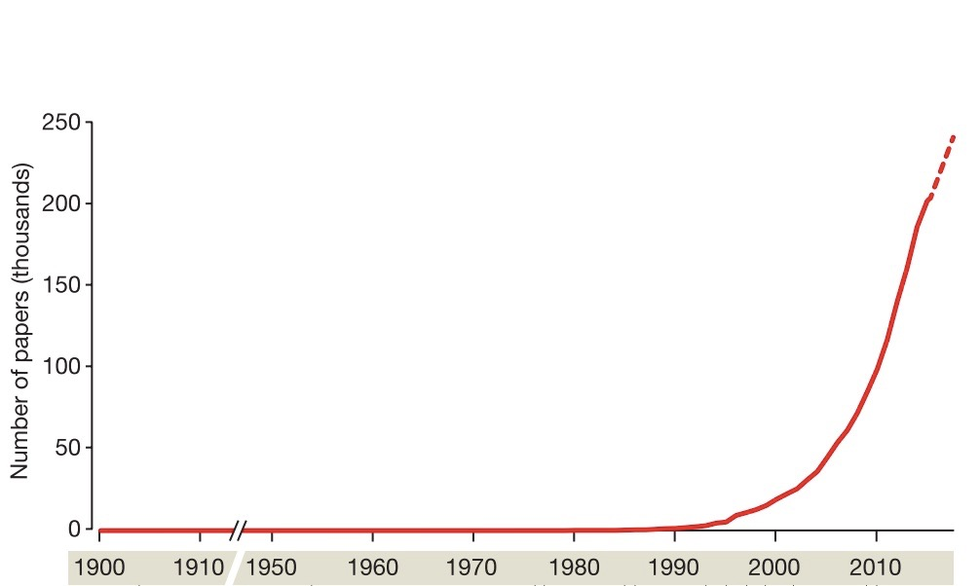
Research synthesis are trendy…
metaforest
Metafor package (R)
PRISMA guidelines
Colaboration for
environmental evidence
First synthesis:
James Lind
Cochrane Collaboration
Developed in medicine
First meta-analysis:
Pearson
Gurevitch et al. (2018), Nature
Gurevitch et al. (2018), Nature

Slide 28
New trends in systematic reviews
A strong methodological development in recent years:
- Metaforest (random forest adapted to meta-analyses)
- Distributional random forest (model several Y variable simultanoulsy)
- Bayesian statistics
- clarification of the factors explaining the values observed for
each individual
- Cumulative meta-analyses and living reviews
- Automation of various steps of the meta-analyses
- webplatform to present and difuse the results
-…
Gurevitch et al. (2018), Nature

Slide 29
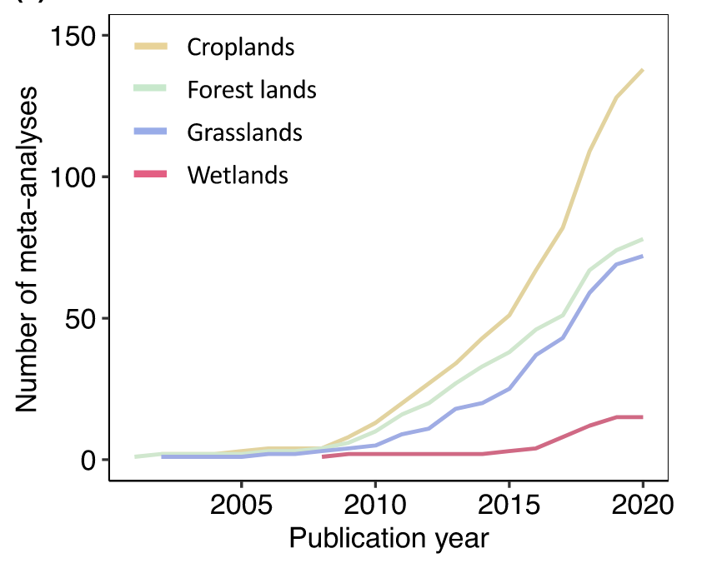
An increrase in the number .. But what about the quality?
BUT
« Too many meta-analyses and
systematic reviews are of low quality »
Number of meta-analyses published
on Soil organic carbon
« Education in high-quality research-synthesis methods »
Gurevitch et al. (2018), Nature

Slide 30
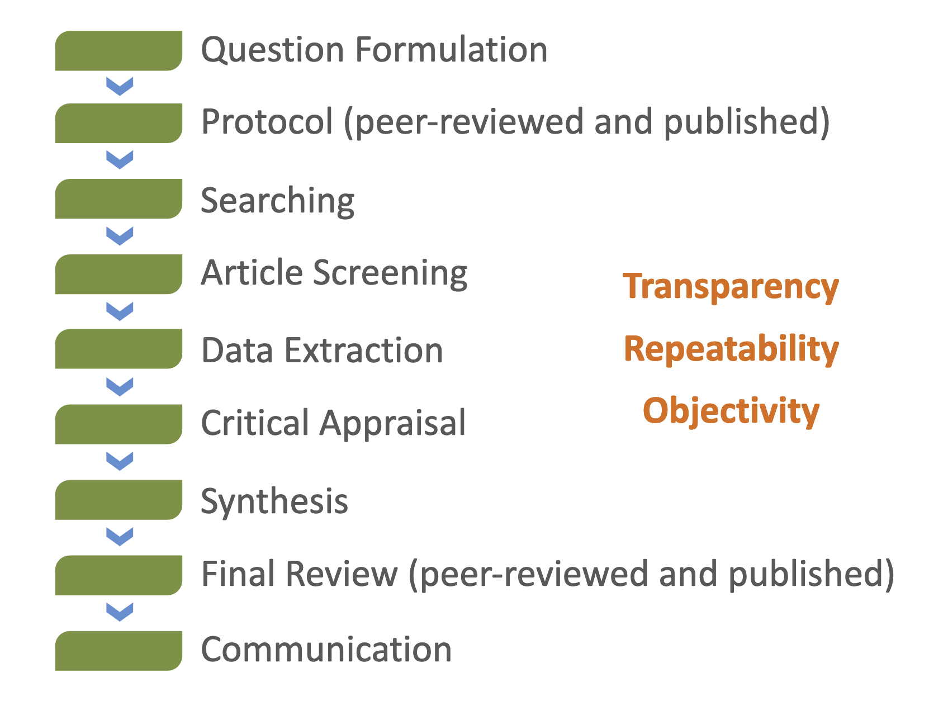
The different steps to perform a systematic review
Gurevitch et al. (2018), Nature

